Slide 1

Unit - I
Introduction to Microprocessor
Reference:
Muhammad Ali Mazidi, Sarmad Naimi, SepehrNaimi, “The stm32f103 arm microcontroller and embedded systems: Using assembly and c", 1st Edition, MicroDigitalEd, 2020

Slide 2
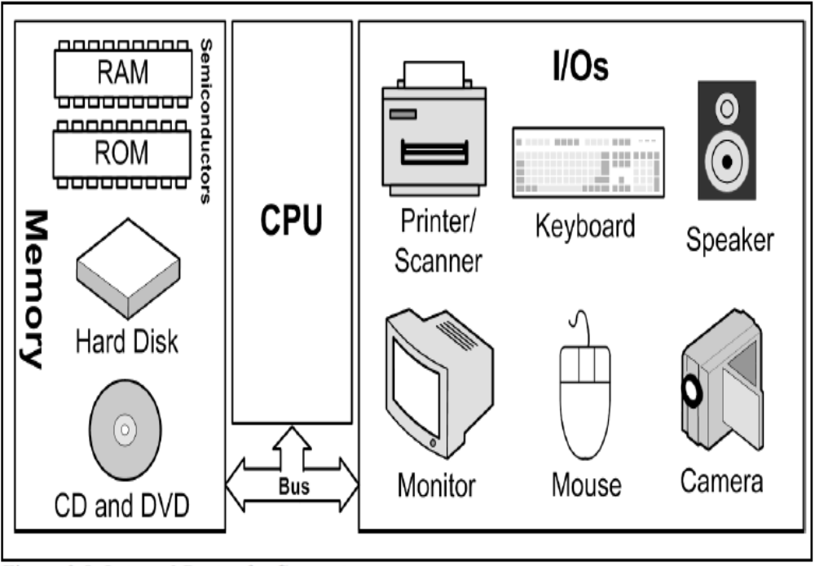
Parts of a Computer

Slide 3
Functional Units of computing System
CPU
Memory
I/O
  Input
    E.g. Keyboard, Mouse, Sensor
  Output
    E.g. LCD, printer, hands of a robot

Slide 4
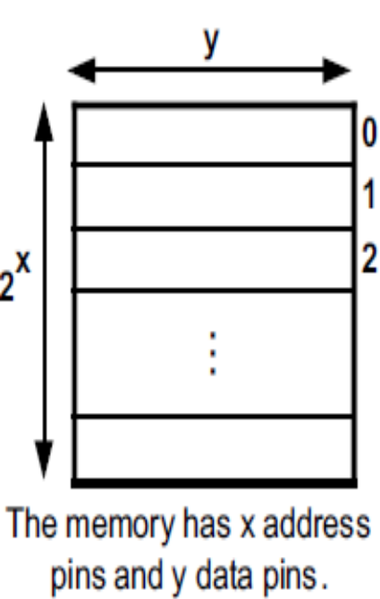
Memory
Everything that can store, retain, and recall information.
  E.g. hard disk, a piece of paper, etc.
A memory chip contains 2^{x} locations
Each location contains y bits
The entire chip will contain 2^{x} × y bits

Slide 5
Memory characteristics
Capacity
  The number of bits that a memory can store.
    E.g. 128 Kbits, 256 Mbits
Organization
  How the locations are organized
    E.g. a 128 x 4 memory has 128 locations, 4 bits each
Access time
  How long it takes to get data from memory
4 bits
0
1
2
128 locations
…
127

Slide 6
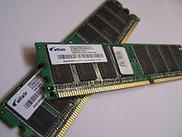
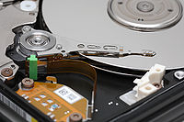
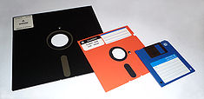
Memory
Semiconductors
Non-semiconductors
The pictures are copied from http://www.wikipedia.org/

Slide 7
Semiconductor memories
ROM
  Mask ROM
  PROM (Programmable ROM)
  EPROM (Erasable PROM)
  EEPROM (Electronic Erasable PROM)
  Flash EPROM
RAM
  SRAM (Static RAM)
  DRAM (Dynamic RAM)
  NV-RAM (Nonvolatile RAM)

Slide 8
Memory\ROM\Mask ROM
Programmed by the IC manufacturer

Slide 9
Memory\ROM\PROM (Programmable ROM)
OTP (One-Time Programmable)
  You can program it only once

Slide 10

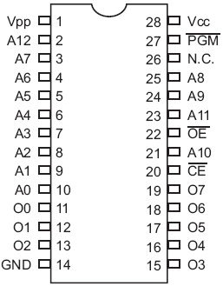
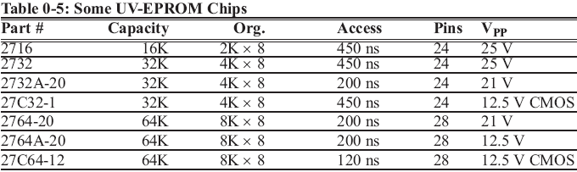
Memory\ROM\EPROM (Erasable Programmable ROM)
UV-EPROM
  You can shine ultraviolet (UV) radiation to erase it
  Erasing takes up to 20 minutes
  The entire contents of ROM are erased
2764

Slide 11
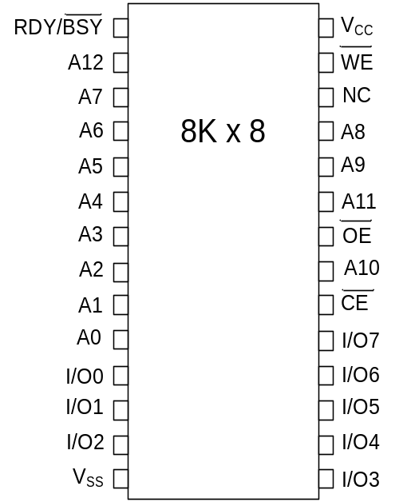
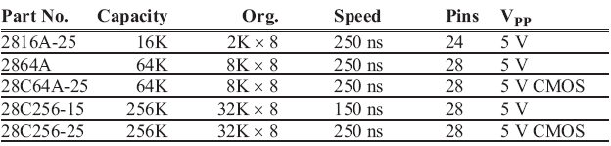
Memory\ROM\EEPROM (Electrically Erasable Programmable ROM)
Erased Electrically
  Erased instantly
  Each byte can be erased separately

Slide 12
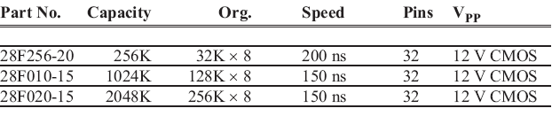
Memory\ROM\Flash ROM
Erased in a Flash
the entire device is erased at once

Slide 13
Semiconductor memories
ROM
  Mask ROM
  PROM (Programmable ROM)
  EPROM (Erasable PROM)
  EEPROM (Electronic Erasable PROM)
  Flash EPROM
RAM
  SRAM (Static RAM)
  DRAM (Dynamic RAM)
  NV-RAM (Nonvolatile RAM)

Slide 14
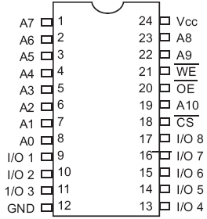
Memory\RAM\SRAM (Static RAM)
Made of flip-flops (Transistors)
Advantages:
  Faster
  No need for refreshing
Disadvantages:
  High power consumption
  Expensive
2K x 8
SRAM

Slide 15
Memory\RAM\DRAM (Dynamic RAM)
Made of capacitors
Advantages:
  Less power consumption
  Cheaper
  High capacity
Disadvantages:
  Slower
  Refresh needed

Slide 16
Memory\RAM\NV-RAM (Nonvolatile RAM)
Made of SRAM, Battery, control circuitry
Advantages:
  Very fast
  Infinite program/erase cycle
  Non-volatile
Disadvantage:
  Expensive

Slide 17
Internal parts of computers\CPU
Tasks:
  It should execute instructions
    It should recall the instructions one after another and execute them

Slide 18
Connecting I/Os to CPU
CPU should have lots of pins!
Mouse
CPU
Network
Keyboard
Sound Card
Graphic Card

Slide 19
Connecting I/Os to CPU using bus
CPU
Address bus
Data bus
Control bus
Write
Read
I/O 0
I/O 1
I/O 2
I/O n

Slide 20
BUS
Connection path between two or more devices. Physically just a collection of wires on which electrical signals can pass.
  The address bus
  The data bus
  The control Bus

Slide 21
Data bus
Used to transfer data between CPU and the memory.
The width of the data bus determines the maximum amount of data the CPU can access per memory cycle.
  Width is critical to performance. If 8-bits wide, the CPU needs 2 memory cycles to fetch 16-bits of data.

Slide 22
Address bus
Helps identify the source and destination of the data being floated on the data bus.
If the CPU wishes to read a certain memory location, it puts that address on the address-bus.
Width of the address bus determines the maximum memory capacity of the system.
  Can also be used to address I/O ports.
  Typically higher order bits are used to select the module on the bus, lower order bits select the location

Slide 23
Control bus
Used to control the access to data and address bus. Needed because data and address lines are shared by all components.
Control signals transmit both command and timing information between system modules. Example control signals (not all used in every processor):
  Memory Write - Data on the bus written to addressed memory location
  Memory Read - Data from the addressed memory location placed on bus

Slide 24
Inside the CPU
PC (Program Counter)
Instruction decoder
ALU (Arithmetic Logic Unit)
Registers
CPU
ALU
PC
A
B
C
Instruction decoder
D
registers

Slide 25
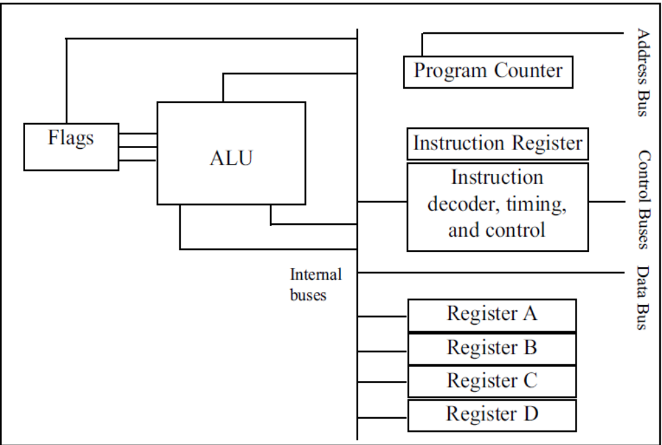
Inside the CPU

Slide 26
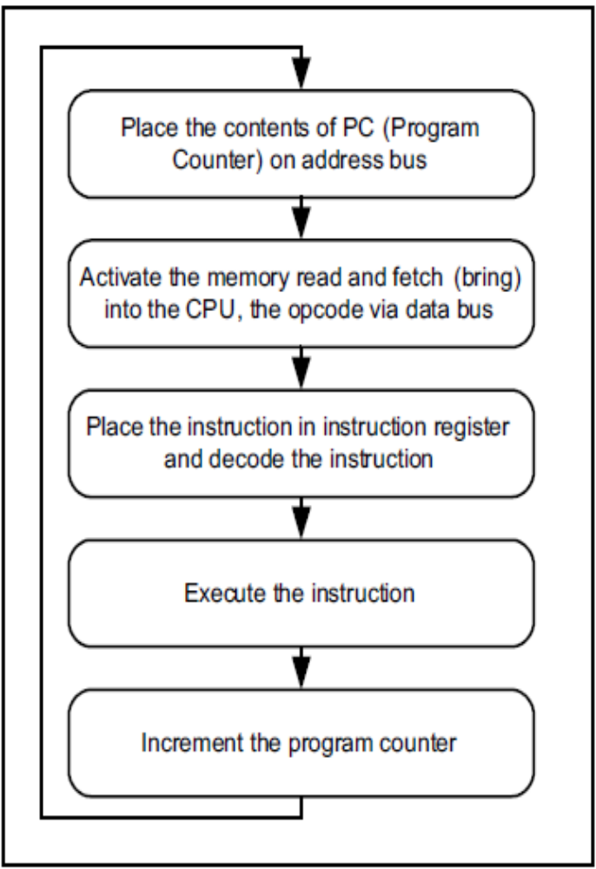
Internal working of CPUs

Slide 27
Introduction to Microprocessor
Microprocessor is a controlling unit of a micro-computer
Consists of an ALU, register array, and a control unit
Fabricated on a small chip capable of performing ALU operations and communicating with the other devices connected to it

Slide 28
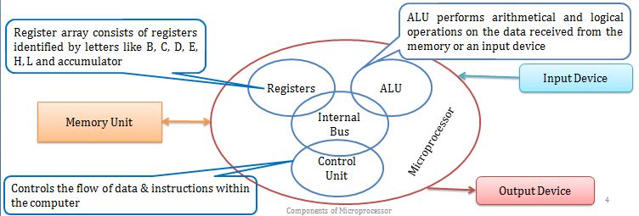
Introduction to Microprocessor

Slide 29
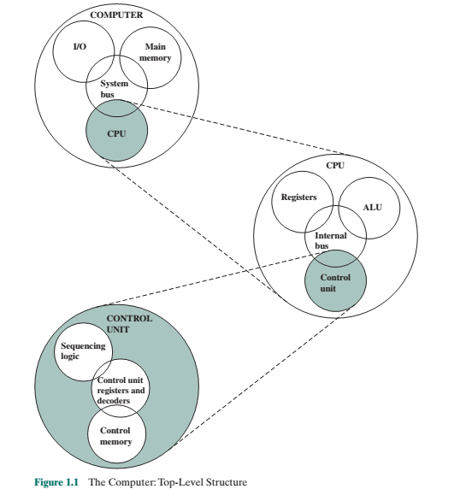
Hierarchical view of Computer
Central processing unit (CPU): Controls the operation of the computer and performs its data processing functions; often simply referred to as processor.
Main memory: Stores data
I/O: Moves data between the computer and its external environment
System interconnection: Provides communication among CPU, main memory, and I/O.
(system interconnection is by means of a system bus, consisting of a number of conducting wires to which all the other components attach)

Slide 30
Hierarchical view of Computer
Major structural components of CPU are as follows:
Arithmetic and logic unit (ALU)
Registers
Control unit
CPU interconnection
ALU: Performs the computer’s data processing functions
Registers: Provides storage internal to the CPU
Control unit: Controls the operation of the CPU and hence the computer.
CPU interconnection: Some mechanism that provides for communication among the control unit, ALU, and registers.

